Slide 1
Tensile strength of corroded cable
“A Study on the Effect of Red Rust on Cables”
KATSUAKI NISHIAZAWA
July 30th, 2025
Notes:
I will now begin my presentation.My research is on the effect of red rust on the tensile strength of cables.

Slide 2
1. Introduction
I think understanding how rust affects cables would be helpful in inspections and repairs.
Notes:
First of all, an introduction. I will explain why I am doing this research. In my opinion, cables are a weak point in cable-stayed bridges.
The reason is that if the cables deteriorate and break, a chain reaction collapse can occur.
This can lead to the collapse of the bridge. I think understanding how rust affects cables would be helpful in inspections and repairs.

Slide 3
2. Objectives
Study the relationship between red rust and tensile strength.
Clarify how rust composition affects cable performance
Investigate the percentage of red rust that affects strength.
Notes:
Next, I will explain the purpose.
Study the relationship between red rust and tensile strength.
Clarify how rust composition affects cable performance
Investigate the percentage of red rust that affects strength. This will give us an idea of whether they need to be repaired or replaced if rusting occurs.

Slide 4
3.Methodology
1.Image analysis of cables.
Find the percentage of red rust in the image.
Compare the results of image analysis with the results of manual calculations.
2. Tension test
Notes:
The flow of the study is as followsI will do an image analysis of cables to determine the percentage of rust. Then I will do a tension test.

Slide 5
3.Methodology
1.Image analysis of cables.
Find the percentage of red rust in the image.
Compare the results of image analysis with the results of manual calculations.
2. Tension test
Notes:
First, I will explain about Image analysis of cables.
Find the percentage of red rust in the image.
Compare the results of image analysis with the results of manual calculations.
It would allow us to be more accurate in our image analysis.

Slide 6
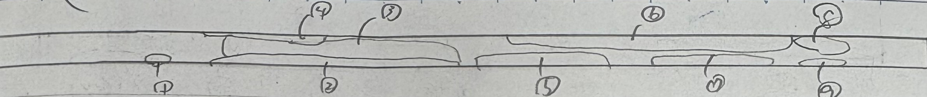
3.1.1 Manual calculations
The method is to draw rust on the cable.
Then, measure the dimensions with calipers.
Notes:
First, I will calculate the percentage of rust by hand.
he method is to draw rust on the cable.
Then, measure the dimensions with calipers.

Slide 7
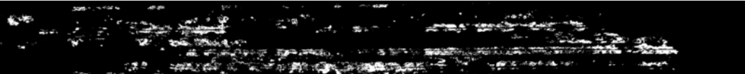
3.1.2 Image analysis
The method is based on a binarization program.
Displays the color of the specified number in white.
This method displays the color of the specified value in white.
Notes:
Then, we will examine the percentage of rust by Image analysis.
The method is based on a binarization program.
This method displays the color of the specified value in white.

Slide 8
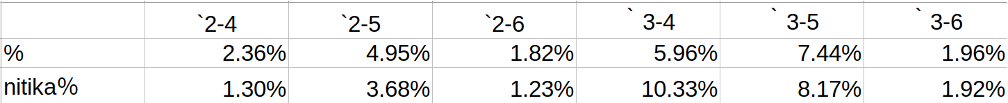
3.1.3 Comparison
The comparison resulted in the errors shown in the table.
The 4.37% error is the largest error.
Notes:
The two results are then compared. he comparison resulted in the errors shown in the table.
The 4.37% error is the largest error.

Slide 9



3.1.4 About this Program
Notes:
This section explains how to specify colors.Specify three factors: hue, saturation, and lightness for the range of colors you want to examine.
These values are called HSV values.
The top image is the one used for the analysis.
The second image shows the recognized colors ranging from light brown to black.
The third image shows a recognized brown color that is nearly black.
These images show that changing the HSV value changes the amount of rust recognized. The result was 8.17% for the second image.The third image is 3.37%.It was found that the color to be discriminated depended on the value specified.

Slide 10
3.1.4 About this Program
The type and percentage of rust can be finely divided.
It is possible to determine how much rust affects the strength.
Notes:
From these we can say the followingThe type and percentage of rust can be finely divided.It is possible to determine how much rust affects the strength. The type and percentage of rust can be finely divided.

Slide 11
3.Methodology
1.Image analysis of cables.
Find the percentage of red rust in the image.
Compare the results of image analysis with the results of manual calculations.
2. Tension test
Notes:
Next, we will explain about the tension test.

Slide 12
3.2 Tension test
←Cable
←Machine
Notes:
We Fix the cables to the opportunity.Then, we operate the lower fixed part downwards.
The cable is pulled and stretched vertically.When it reaches the limit, it breaks.

Slide 13
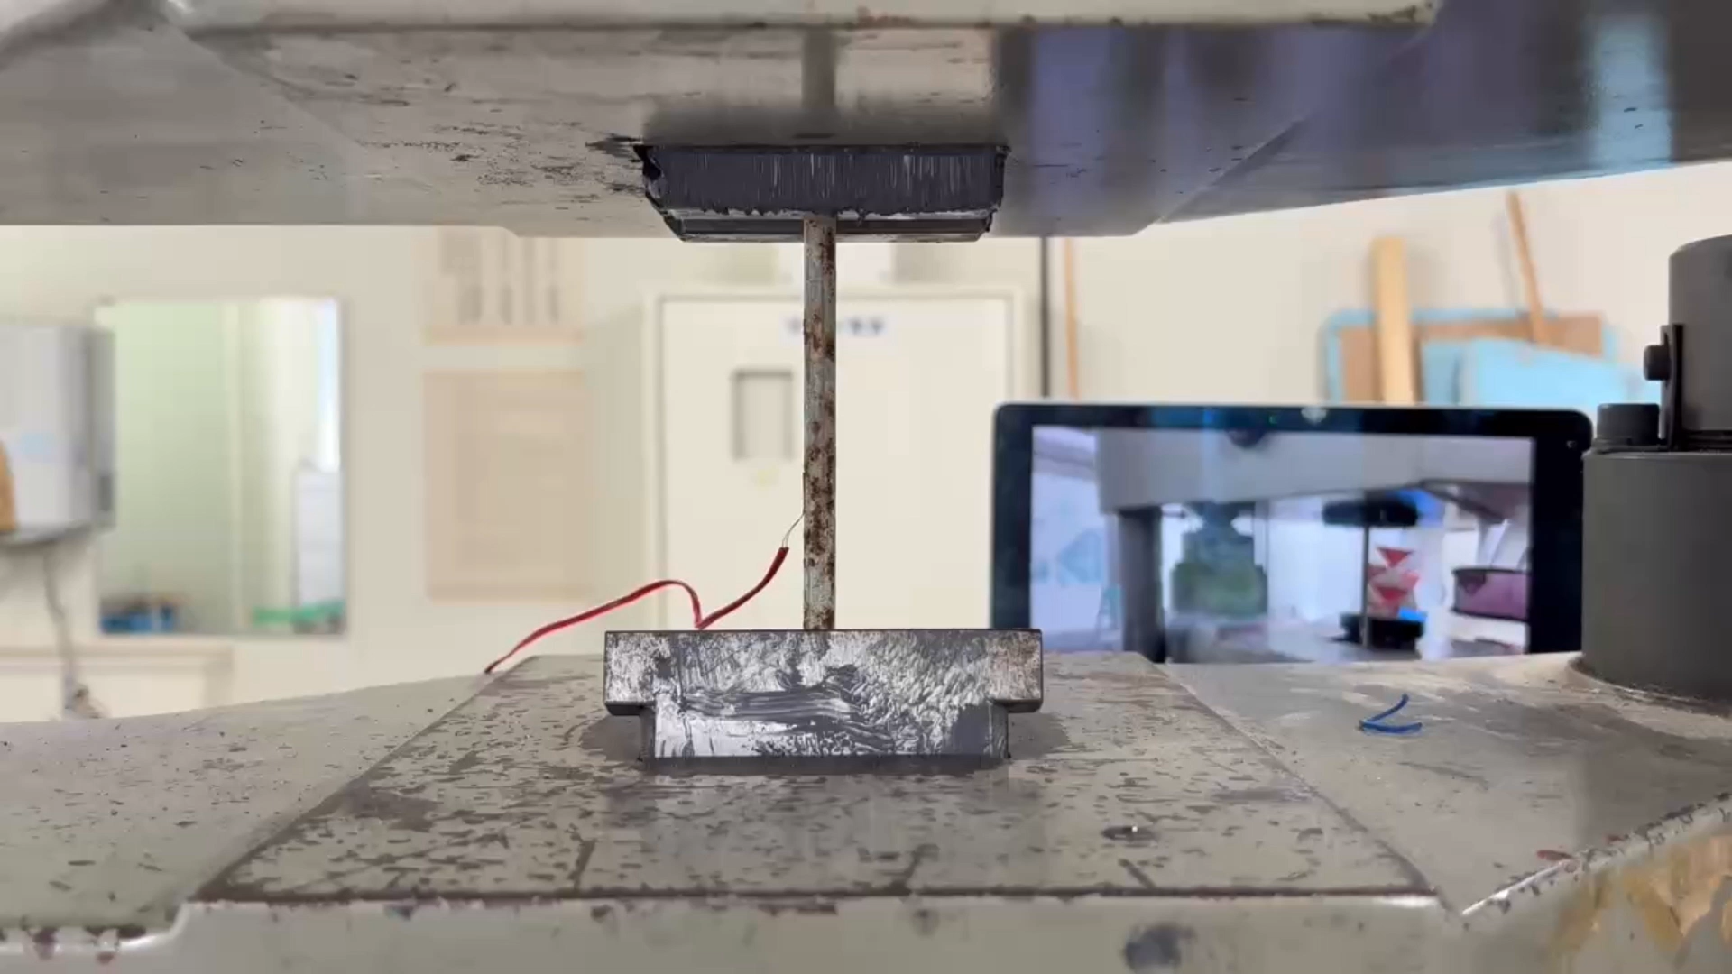
3.2 Tension test
Notes:
See this video.
This is a 16x speed-up of the video of the experiment.

Slide 14
Notes:
荷重ーひずみ
Next, look at these graphs.These are load-strain distributions.
The maximum load was about 65 kN in all cases.
The load at rupture was 50 kN for all of them.

Slide 15
Notes:
応力ーひずみ
Next, look at these graphs.These are stress-strain distributions.

Slide 16
Notes:
The following table shows a summary of the stresses at maximum strain.

Slide 17
3.2 Tension test
Cable | stress | Maximum Strain
1–6 | 1705.2 | 43510.6
1–7 | 1699.9 | 52641.3
2–5 | 1649.4 | 70.2
2–6 | 1501.0 | 9185.6
2–11 | 1683.2 | 45394.2
2–12 | 1635.3 | 30457.7
3–5 | 1489.8 | 15220.2
3–6 | 1536.7 | 5176.9
3–7 | 1653.0 | 63.6
3–10 | 1511.3 | 19222.1
Notes:
The stress at the maximum strain value varied slightly from level to level.

Slide 18
3.2 Tension test
Cable | stress | Maximum Strain
1–6 | 1705.2 | 43510.6
1–7 | 1699.9 | 52641.3
2–5 | 1649.4 | 70.2
2–6 | 1501.0 | 9185.6
2–11 | 1683.2 | 45394.2
2–12 | 1635.3 | 30457.7
3–5 | 1489.8 | 15220.2
3–6 | 1536.7 | 5176.9
3–7 | 1653.0 | 63.6
3–10 | 1511.3 | 19222.1
Notes:
The stress at the maximum strain value varied slightly from level to level. The stress at level 1 averages 1702.55 kN.The stress at level2 averages 1611.1 kN.The stress at level 3 averages 1547.7 kN.

Slide 19
3.2 Tension test
Cable | stress | Maximum Strain
1–6 | 1705.2 | 43510.6
1–7 | 1699.9 | 52641.3
2–5 | 1649.4 | 70.2
2–6 | 1501.0 | 9185.6
2–11 | 1683.2 | 45394.2
2–12 | 1635.3 | 30457.7
3–5 | 1489.8 | 15220.2
3–6 | 1536.7 | 5176.9
3–7 | 1653.0 | 63.6
3–10 | 1511.3 | 19222.1
Notes:
The stress at the maximum strain value varied slightly from level to level. The stress at level 1 averages 1702.55 kN.The stress at level2 averages 1611.1 kN.The stress at level 3 averages 1547.7 kN.

Slide 20
3.2 Tension test
Cable | stress | Maximum Strain
1–6 | 1705.2 | 43510.6
1–7 | 1699.9 | 52641.3
2–5 | 1649.4 | 70.2
2–6 | 1501.0 | 9185.6
2–11 | 1683.2 | 45394.2
2–12 | 1635.3 | 30457.7
3–5 | 1489.8 | 15220.2
3–6 | 1536.7 | 5176.9
3–7 | 1653.0 | 63.6
3–10 | 1511.3 | 19222.1
Notes:
The stress at the maximum strain value varied slightly from level to level. The stress at level 1 averages 1702.55 kN.The stress at level2 averages 1611.1 kN.The stress at level 3 averages 1547.7 kN. It was found that there is a difference of about 150 kN between a sound cable and a level 3 cable.

Slide 21
4.Conclusion
The load at rupture was 50 kN for all of them.
The maximum load was about 65 kN in all cases.
The stress at the maximum strain value varied slightly from level to level.
Notes:
The results obtained from the experiment are as follows
The load at rupture was 50 kN for all of them.
The maximum load was about 65 kN in all cases.
The stress at the maximum strain value varied slightly from level to level.

Slide 22
5. Future Work
To create a graph of the relationship between the percentage of rust and maximum strain.
Examine the elongation from the image at the time of the experiment.
Notes:
Future Work.
To create a graph of the relationship between the percentage of rust and maximum strain.
Thank you for your attention.

Slide 23
Images used for image analysis
Image analysis
calculating by hand
Notes:
Q,なぜ差が出たと思う？
要因は錆びの面積の計算方法の違いにあると私は思う。
Pythonは錆びを画像のように白く染めて、その面積を計算している。
手計算では画像のように錆びの部分を丸く囲み、縦と横の長さをかけることで錆びの面積を求めている。
後者の方法では錆びていない部分を錆びと判断してしまう、
また、目視のため見逃してしまうサビもある。
そのため、値が大きく出たり、小さく出たりする。
このように違う方法を用いているため、誤差が生まれる。
I believe the factor lies in the difference in the way the area of the rust is calculated.Python calculates the area of rust by dyeing the rust white as shown in the image.In manual calculation, the area of rust is calculated by circling the rusty area as shown in the image and multiplying the length and width of the rust by the length and width of the rust.The latter method determines rust in areas that are not rusted, and there is also rust that is missed due to visual inspection.Therefore, the value may be large or small.This different method results in an error.

