Slide 1
“A Risk Assessment of Yuri Bridge”
7022609 Daiki Maniwa

Slide 2
Table of contents
・Research Objectives
・Research methods
・Survey results
・Next Steps of my research

Slide 3
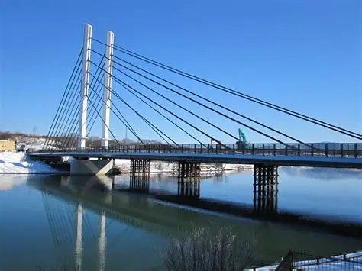
Research Objectives
Riskassessment
Risk assessment is the process of quantitatively determining potential risks for a bridge prior to construction using historical data.
ReserachObjecyive
・In February, there was an accident in which a bolt fell from the Yuri Bridge.
I conduct risk assessments using meteorological data to determine what measures are needed to prevent such accidents.
Figure 1 Yuri Bridge
https://yurihonjo-kanko.jp/taxi_%E7%94%B1%E5%88%A9%E6%A9%8B/

Slide 4
Research methods
・Conduct a risk assessment for Yuri Bridge from a meteorological perspective.
・To conduct the risk assessment, I examined 10minute interval data（January 2024 to～February 2025） on mean wind speed, wind direction, air temperature, and precipitation, and evaluated the year-round conditions of Yuri Bridge.
Used Data ： Information from the Japan Meteorological Agency
https://www.data.jma.go.jp/stats/etrn/index.php?prec_no=32&block_no=0199&year=2025&month=01&day=01&view=

Slide 5
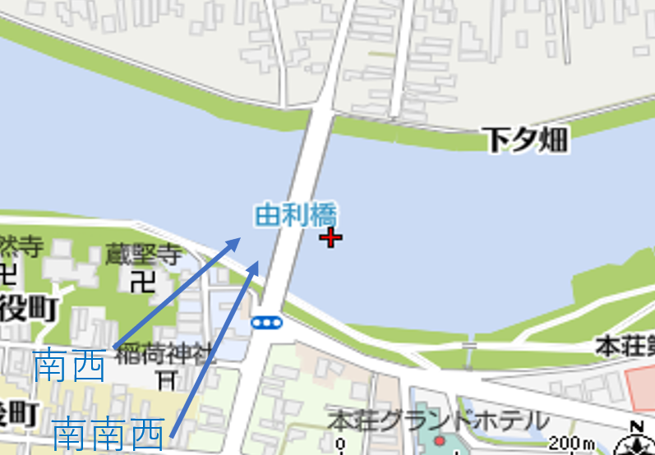
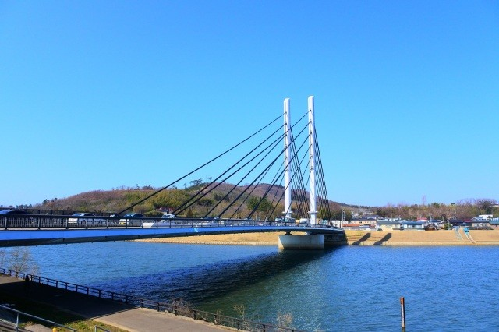
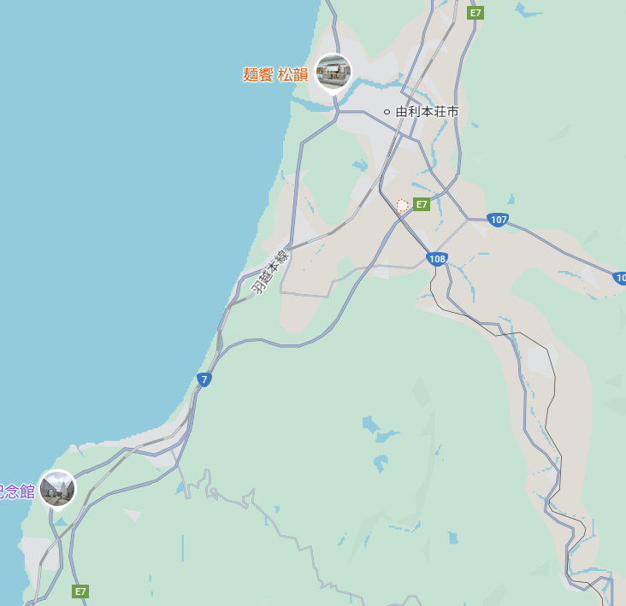

Observation points
Bridge tower
Yuri Bridge
https://www.tohokukanko.jp/attractions/detail_1007608.html
Precipitation and Temperature
(Yurihonjo City,Umeta Yozeki Minami)
・Precipitation and temperature data were obtained from the Japan Meteorological Agency station located approximately 5 kilometers from the Yuri Bridge
・ Wind direction and average wind speed data were obtained from the Japan Meteorological Agency station located in Nikaho City, which is near the coastal area (a location about 24 kilometers from Yuri Bridge)。
Average wind speed
and wind direction
(Nikaho City)

Slide 6
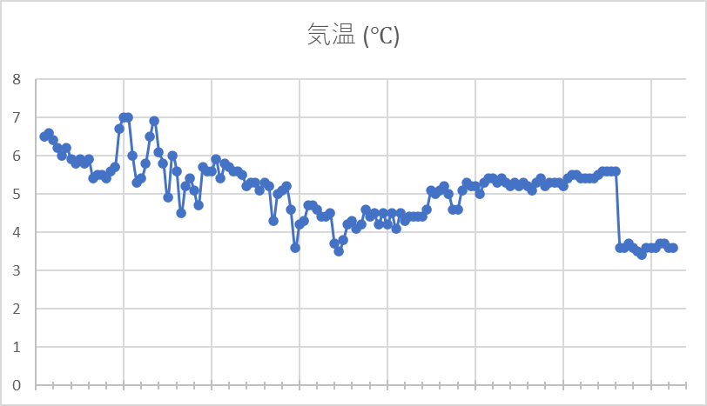
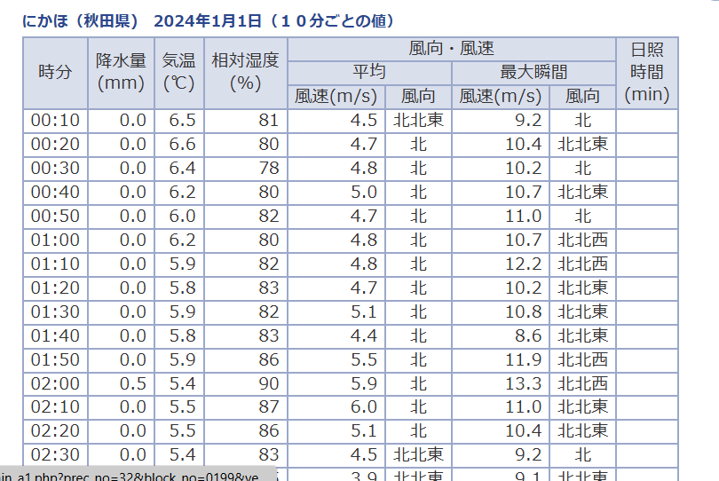
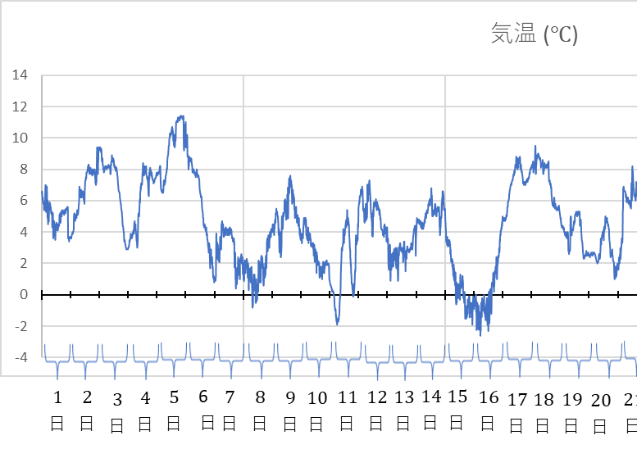
How to use data
magnification
https://www.data.jma.go.jp/stats/etrn/index.php?prec_no=32&block_no=0199&year=2025&month=01&day=01&view=
Using 10-minute interval data, graphs of temperature, precipitation, average wind speed, and wind direction were created.
And Each graph was then compared.

Slide 7
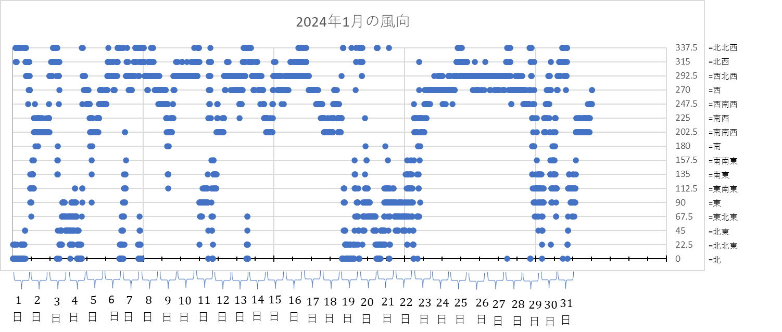
About the graph of wind direction
Convert wind directions (north, east, south, west) into angles in degrees, then make a scatter plot to show their relationship.

Slide 8
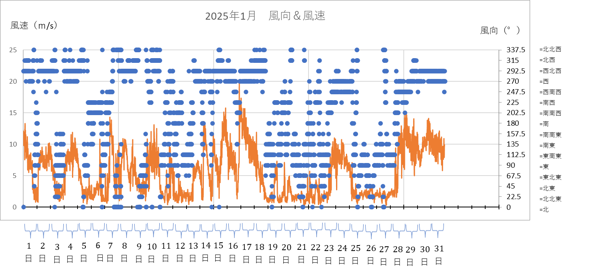
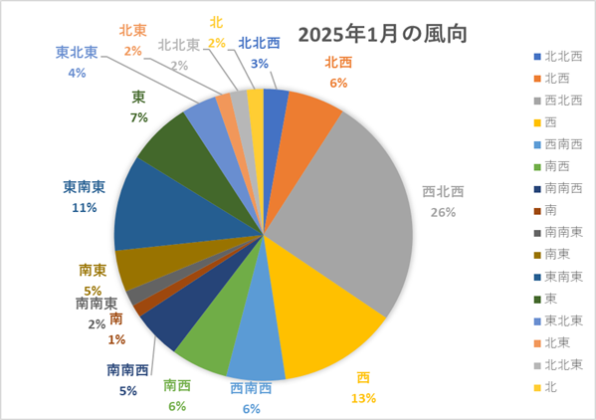
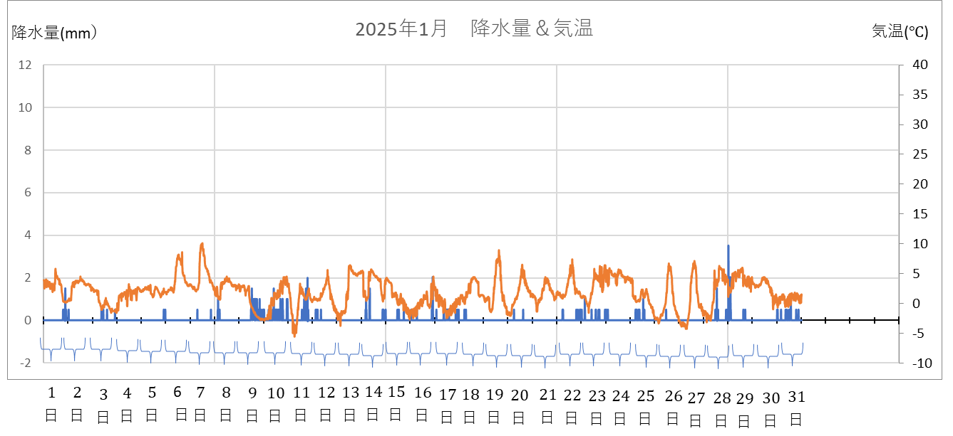
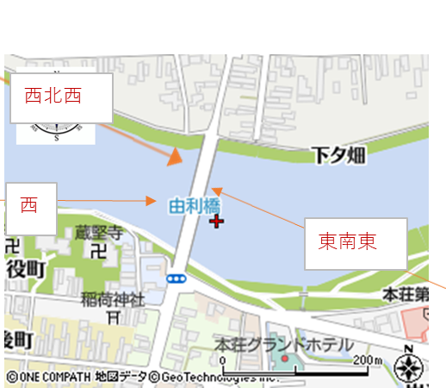
Results from January 2025

Slide 9
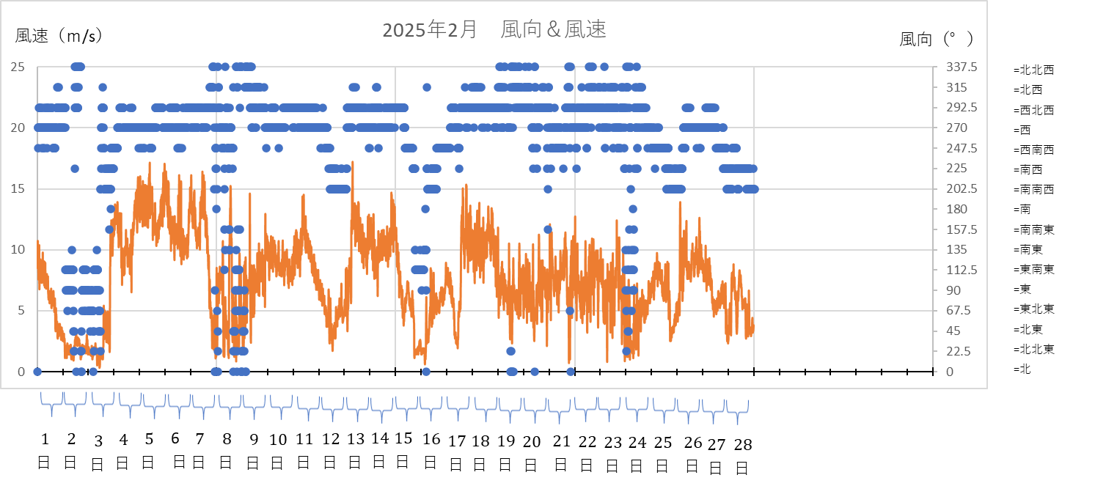
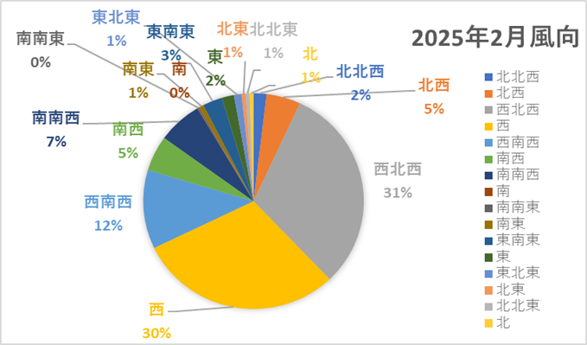
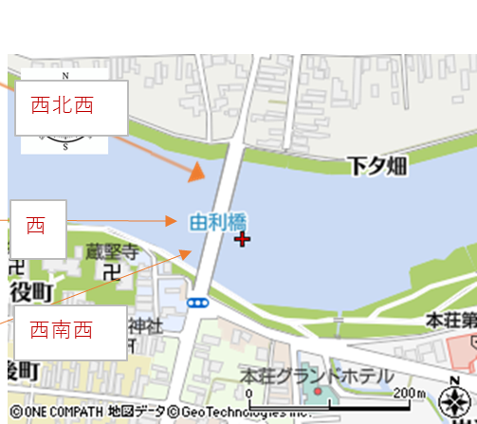
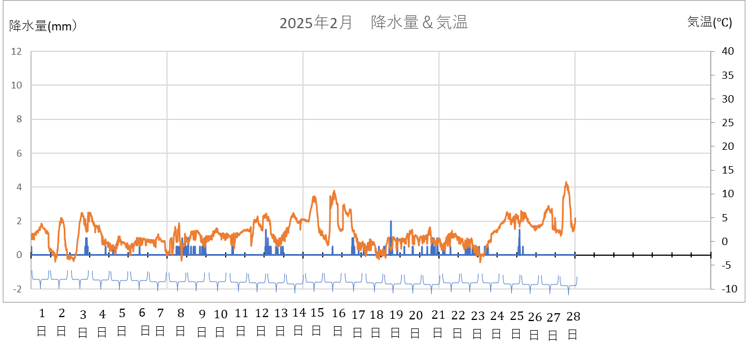
Results from February2025

Slide 10
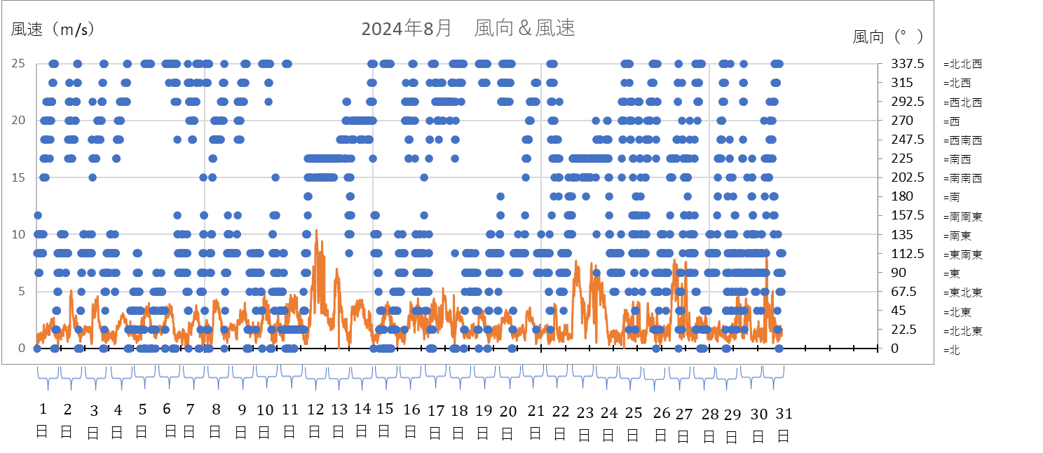
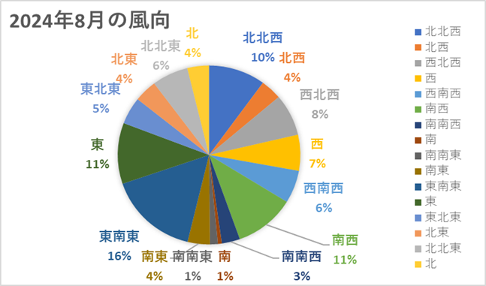
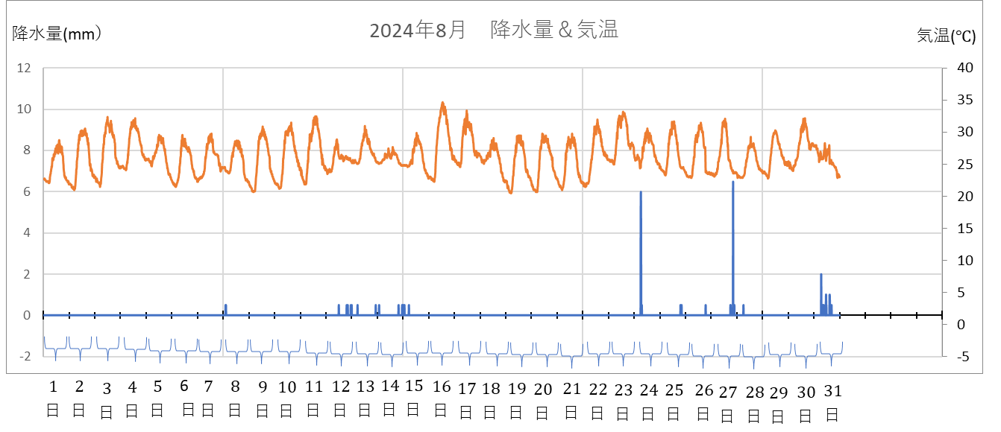
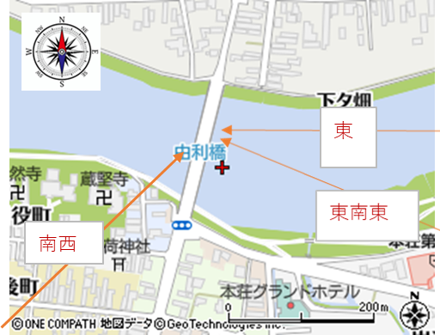
Results from August2025

Slide 11
The findings from the survey
・Throughout the year, winds from the Sea of Japan side are predominant, and as wind speed increases, west and west-northweste winds tend to occur.
・In August, September, and October, wind speeds are relatively low, and winds from the inland side such as east and east-southeast—are more common.
・When wind speeds are low, wind direction tends to be more variable.

Slide 12
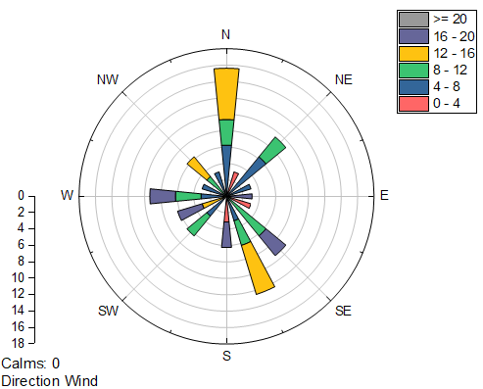
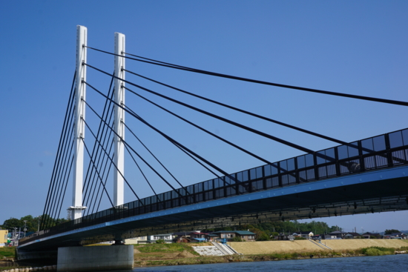
Next Steps
Figure 1 Wind Rose Examples
https://www.originlab.com/doc/ja/Tutorials/Windrose-Graph
・ To create ｗind roses using the data collected in this study.
・Graph illustrating maximum instantaneous wind speed based on observed data.
・The effects of north-northwest winds on vehicles at the protective barrier height of Yuri Bridge.
Figure 2 Yuri Bridge’s protective barrier
https://yurihonjo-kanko.jp/taxi_%E7%94%B1%E5%88%A9%E6%A9%8B/
Notes:
ウィンドローズの説明
最大瞬間風速を調べる理由
これらの結果やCFDのデータを利用して風による車の動きを計算することで、リスクアセスメントをしていく。

Slide 13
Thank you for listening

